Slide 1
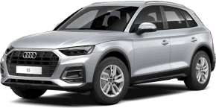
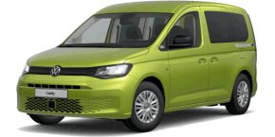
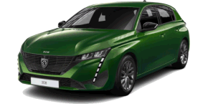
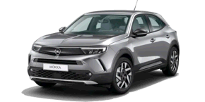
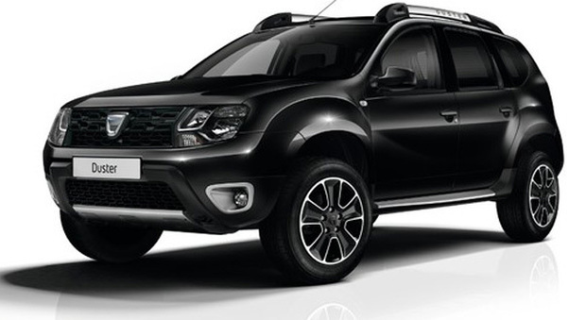
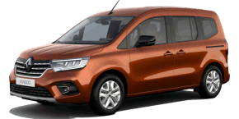
OUTUBRO 2022
VEÍCULOS NOVOS
AUDI Q5 (FY)
Q5 (FY) II Ph.2 2020-09->
VOLKSWAGEN CADDY (SB)
CADDY (SB) V 2021-01->
PEUGEOT 308
308 III 2021-04->
OPEL MOKKA
MOKKA II 2020-12->
DACIA DUSTER
DUSTER II Ph.2 2021-10->
RENAULT KANGOO
KANGOO III 2020-10->

Slide 2
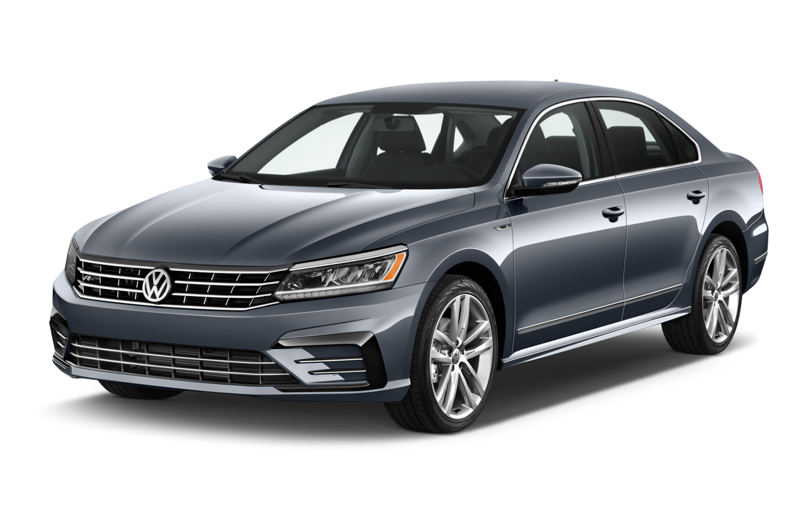
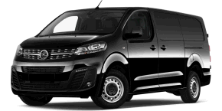
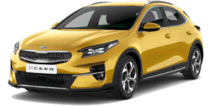
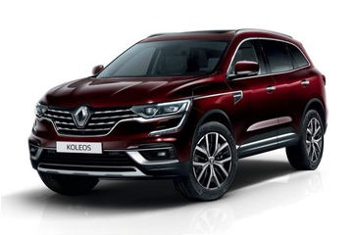
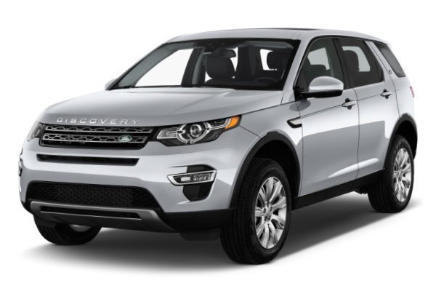
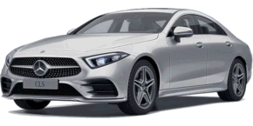
OUTUBRO 2022
VEÍCULOS ACTUALIZADOS
VOLKSWAGEN PASSAT (3G)
PASSAT (3G) VII Ph.2 2019-07->
OPEL VIVARO
VIVARO (C/-) III 2019-06->
KIA XCEED
XCEED 2019-09->
RENAULT KOLEOS
KOLEOS II Ph.2 2019-09->
LAND ROVER DISCOVERY
DISCOVERY SPORT Ph.2 2019-06->
MERCEDES CLASSE CLS
CLASSE CLS (C257) III 2018-01->

Slide 3
Veículos novos
MARCA | MODELO
AUDI | E-TRON GT (FW) 2021-04->
AUDI | Q4 (FZ) 2021-06->
AUDI | Q5 (FY) II Ph.2 2020-09->
DACIA | DUSTER II Ph.2 2021-10->
DS | DS4 II 2020-10->
FORD (EU) | FIESTA VII Ph.2 2021-10->
FORD (EU) | MUSTANG MACH-E 2020-12->
HONDA | CIVIC X Ph.2 2020-01->
HONDA | HR-V III 2021-10->
HYUNDAI | ELANTRA III 2020-09->
JEEP | GLADIATOR 2020-09->
MERCEDES | CITAN II 2021-10->
MERCEDES | CLASSE C V 2021-06->
DACIA | DUSTER II Ph.2 2021-10->
DS | DS4 II 2020-10->
MARCA | MODELO
MERCEDES | CLASSE GLE COUPE (C167) II 2019-09->
MINI | MINI (F55/F56/F54/F57/F60) III Ph.2 2019-09->
NISSAN | QASHQAI III 2021-06->
OPEL | INSIGNIA II Ph.2 2020-12-> $
OPEL | MOKKA II 2020-12->
PEUGEOT | 308 III 2021-04->
RENAULT | KANGOO III 2020-10->
SEAT | 124 1976-01->1982-05
SEAT | 127 1976-01->1981-12
SEAT | 131 1978-06->1986-12
SEAT | 133 1975-05->1980-12
SEAT | 600 1960-01->1974-12
SEAT | 850 1972-01->1975-12
SEAT | ARONA (KJ) Ph.2 2021-06->
SEAT | FURA 1984-04->1986-06

Slide 4
Veículos novos
MARCA | MODELO
SEAT | PANDA 1980-01->1986-12
SKODA | ENYAQ (NY) 2020-09->
SKODA | FABIA (PJ) IV 2021-07->
TOYOTA | YARIS CROSS 2021-10->
VAUXHALL | INSIGNIA II Ph.2 2020-12-> $
MARCA | MODELO
VAUXHALL | MOKKA II 2020-12->
VOLKSWAGEN | CADDY (SB) V 2021-01->
VOLKSWAGEN | POLO (AW) VI Ph.2 2021-09->
VOLKSWAGEN | TIGUAN (AD) II Ph.2 2020-09->
VOLVO | XC60 II Ph.2 2021-04->

Slide 5
Veículos actualizados
MARCA | MODELO
AUDI | A3 (8Y) IV 2020-03->
AUDI | E-TRON (GE) 2019-04->
AUDI | Q8 (F1) 2018-10->
CITROEN | C3 (A51) II Ph.1 2009-11->2013-02
CITROEN | JUMPY (-/K0) III 2016-03->
DACIA | DUSTER II Ph.1 2017-10->
FIAT | 500 II Ph.2 2015-04->
FIAT | DUCATO III Ph.2 2014-06->
FORD (EU) | FUSION Ph.2 2005-10->2011-09
HYUNDAI | BAYON 2021-07->
HYUNDAI | COUPE II Ph.3 2006-09->2010-10
HYUNDAI | I30 III Ph.1 2017-01->
HYUNDAI | MATRIX Ph.2 2008-09->2010-10
KIA | CEE D III 2018-07->
KIA | XCEED 2019-09->
LAND ROVER | DISCOVERY (L319) IV Ph.1 2009-09->
MARCA | MODELO
LAND ROVER | DISCOVERY (L319) IV Ph.2 2013-09->
LAND ROVER | DISCOVERY SPORT Ph.2 2019-06->
LAND ROVER | RANGE IV Ph.1 2012-09->
LAND ROVER | RANGE IV Ph.2 2018-01->
LAND ROVER | RANGE SPORT I Ph.1 2005-05->2009-09
LAND ROVER | RANGE SPORT I Ph.2 2009-09->2012-12
LAND ROVER | RANGE SPORT II Ph.2 2017-12->
LEXUS | LS III Ph.3 2013-02->
MAZDA | 5 I Ph.1 2005-06->2008-10
MAZDA | 5 I Ph.2 2008-01->2010-10
MAZDA | 6 II Ph.1 2008-01->2010-07
MERCEDES | CLASSE B (W247) III 2019-01->
MERCEDES | CLASSE CLK (C208/A208) I Ph.2 1999-09->2002-12
MERCEDES | CLASSE CLS (C257) III 2018-01->

Slide 6
Veículos actualizados
MARCA | MODELO
MERCEDES | SPRINTER (907) III 2018-06->
OPEL | ASTRA (H) III Ph.1 2004-04->2006-12 $
OPEL | GT II 2007-03->2009-12
OPEL | VIVARO (C/-) III 2019-06->
OPEL | ZAFIRA LIFE 2019-06->
PEUGEOT | 2008 I Ph.1 2013-01->2016-09
PEUGEOT | 208 I Ph.2 2015-04->
PEUGEOT | 3008 (P84) II Ph.1 2016-06->
PEUGEOT | EXPERT (K0) III 2016-03->
RENAULT | CAPTUR I Ph.1 2013-02->2017-12
RENAULT | KOLEOS II Ph.2 2019-09->
RENAULT | MASTER III Ph.3 2019-09->
RENAULT | MEGANE III Ph.1 2008-11->2014-06
RENAULT | TWINGO II Ph.2 2011-12->2014-12
SEAT | IBIZA (021A) I Ph.1 1985-07->1989-01
SEAT | LEON (1P) II Ph.2 2009-05->2012-09
MARCA | MODELO
SEAT | LEON (KL) IV 2020-03->
SEAT | MALAGA Ph.1 1985-10->1989-06
SEAT | MALAGA Ph.2 1989-07->1991-06
SEAT | MARBELLA 1984-01->1998-05
SEAT | MII (KF) Ph.2 2016-10->
SEAT | RONDA 1983-07->1987-06
SEAT | TERRA (24/024A) 1987-07->1995-02
TOYOTA | PRIUS I 2000-11->2004-03
TOYOTA | PRIUS II 2004-03->2009-11
VOLKSWAGEN | GOLF (1K) V 2003-11->2009-12
VOLKSWAGEN | ID3 (E1) 2020-09->
VOLKSWAGEN | PASSAT (3G) VII Ph.1 2014-09->
VOLKSWAGEN | PASSAT (3G) VII Ph.2 2019-07->
VOLKSWAGEN | PHAETON (3D) Ph.1 2002-10->2010-07

Slide 7
Veículos actualizados
MARCA | MODELO
VOLKSWAGEN | POLO (6R/6C) V Ph.1 2009-09->2014-05
VOLKSWAGEN | TIGUAN (AD) II Ph.1 2016-04->
VOLKSWAGEN | TOUAREG (CR) III 2018-07->
VOLKSWAGEN | TOURAN (1T) II 2010-09->2015-12
MARCA | MODELO
VOLKSWAGEN | T-ROC (A1/AC) Ph.1 2017-10->
VOLVO | C30 Ph.2 2009-10->2013-12
VOLVO | V70 I Ph.3 2004-06->2007-10

